Slide 1
Reviving Airbnb Business Revenue Post Covid
By -
Sanjay Tom Perayil
Ritij Srivastava

Slide 2
Agenda
Objective
Key findings
Recommendations
Appendix:
Data Source
Data methodology
Data Assumptions

Slide 3
Objective
For the past few months, Airbnb has seen a major decline in revenue. Now that the restrictions have started lifting and people have started to travel more, Airbnb wants to make sure that it is fully prepared for this change.
The different leaders at Airbnb want to understand some important insights based on various attributes in the dataset so as to increase the revenue such as -
Understand Key Insights from Pre-Covid Period (2011-2019) Data.
Post Covid Business Analysis & Growth Opportunities.
Identify Customer Preferences for Post Covid Travel Rebound.

Slide 4
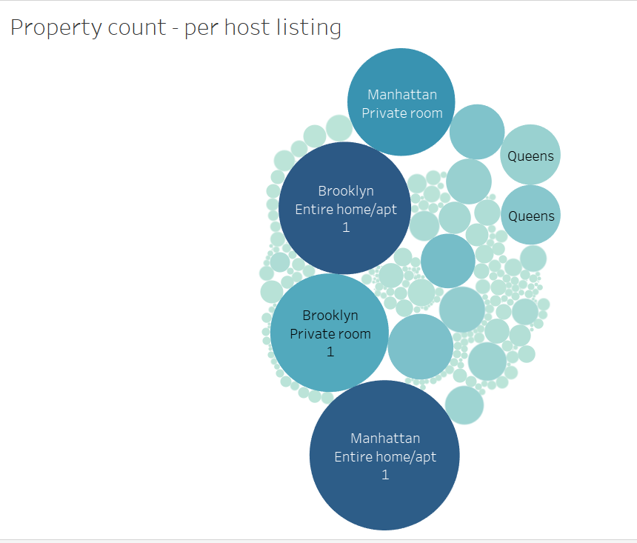
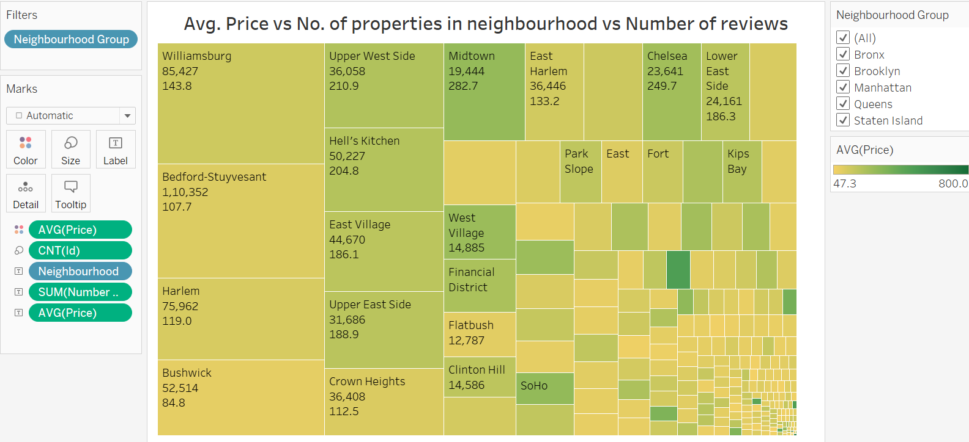
Key Findings
Brooklyn and Manhattan have the highest booking among all the neighborhood group and are the most popular districts.
Bedford & Williamsburg in Brooklyn, and Harlem in Manhattan has the highest bookings in the year 2019.
Properties in Manhattan generates higher revenue for the host with lower bookings.

Slide 5
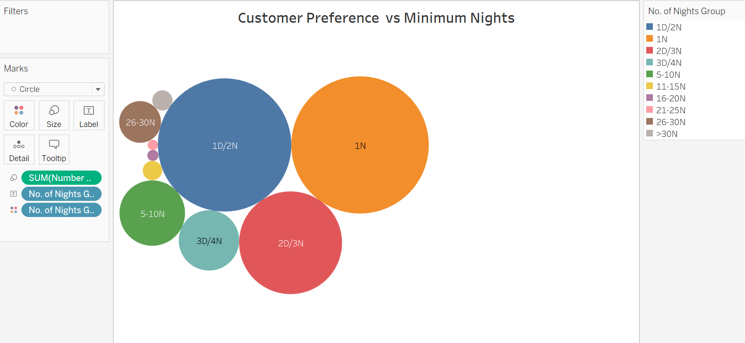
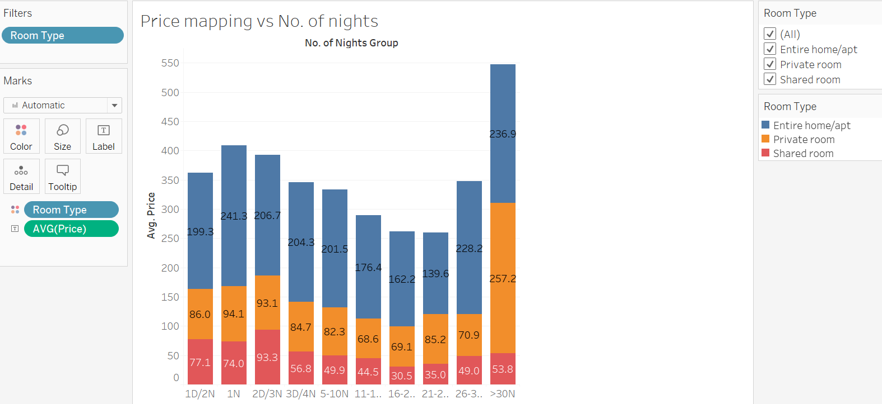
Key Findings
Most no: of bookings are made for minimum night stay for 1,2,3 and 30 days.
Interestingly, those who booked for Private Room and Entire home got the maximum revenue for minimum stay 1 night.
Overall we should focus more on properties having 1,2,3 and 30 minimum night stay.

Slide 6
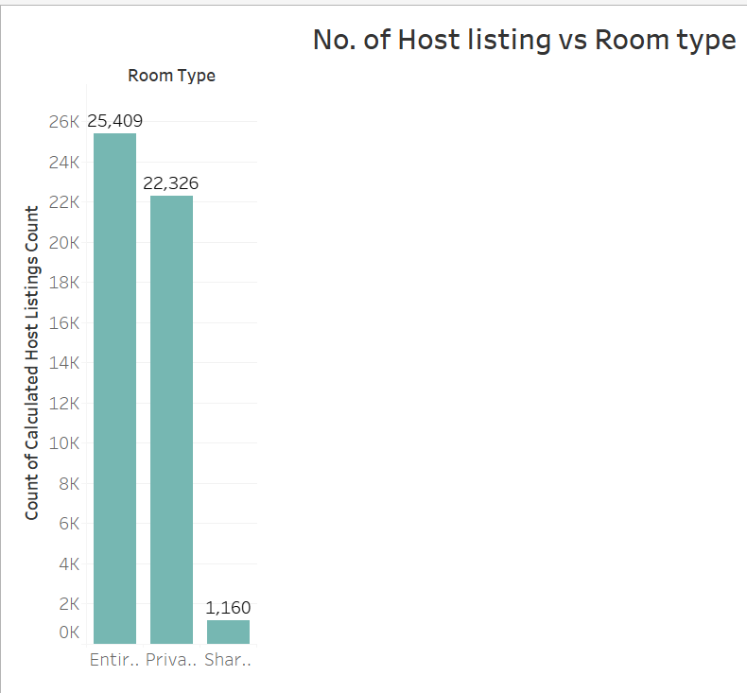
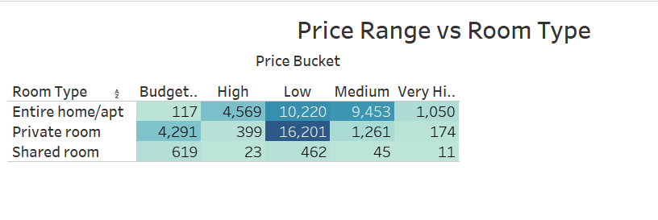
Key Findings
Most no: of bookings are for entire home/apts across all the locations.
The second highest no: of bookings are for are of private rooms across all neighborhoods.
Private rooms has the highest price among all the room types in the price range.

Slide 7
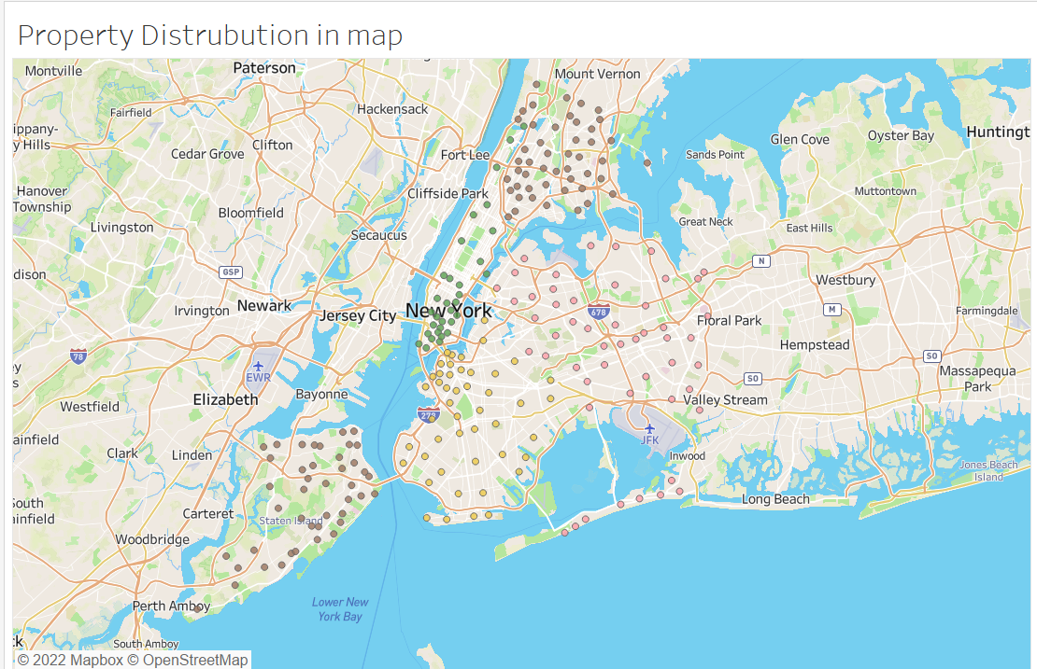
Property Distribution map

Slide 8
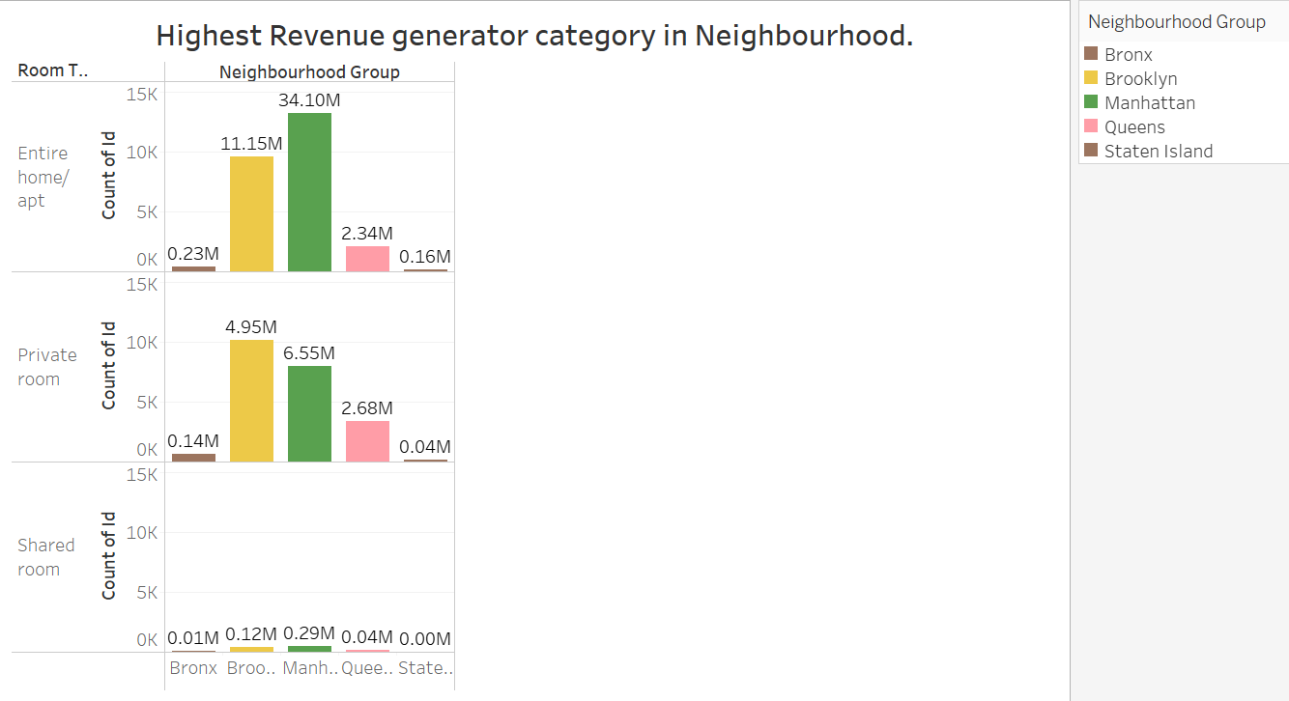
Highest revenue among various room types
The highest revenue is generated by customer choosing the entire home/apt at Manhattan.
Secondly, Brooklyn scores the highest for the private room among all other room type.

Slide 9
Recommendations
Focus on Hosts which are provide stays for shorter than a week or a month.
Acquire more Entire Home/apt and Private room hosts than shared rooms as they are in demand to maximise the revenue.
Focus more on those areas i.e Manhattan and Brooklyn where the revenue generation is pretty high compared to other neighborhood which are popular among the customers.

Slide 10
Appendix – Data Source
Data Source: NYC Airbnb Data set provided
Here is some brief details provided in the data dictionary:
neighborhood, latitude, and longitude.
Room information such as type, minimum nights stayed, and room price.
Customer info such as the number of reviews, last review, etc.

Slide 11
Appendix: Data Methodology
We used tools such as Python Jupiter Notebook mainly to perform various Data cleaning and transforming the data set.
Exploratory Data Analysis
Used Tableau for the data visualization for deeper analysis.
The methodology doc file has been attached for the whole data cleaning, data preparation, data visualization.

Slide 12
Appendix: Data Assumptions
We assumed the data prior to the COVID – 19 period was achieving the desired revenue.
The company’s strategies are decided considering the travel will be increased in the post COVID period.

